Slide 1
Chapter 33 JavaServer Face

Slide 2
Objectives
To explain what JSF is (§33.1).
To create a JSF page using NetBeans (§33.2).
To create a JSF managed bean (§33.2).
To use JSF expressions in a facelet (§33.2).
To use JSF GUI components (§33.3).
To obtain and process input from a form (§33.4).
To track sessions in application, session, view, and request scope (§33.5).
To validate input using the JSF validators (§33.6).
To bind database with facelets (§33.7).

Slide 3
What is JSF?
JSF completely separates Web UI from Java code so the application developed using JSF is easy to debug and maintain.

Slide 4
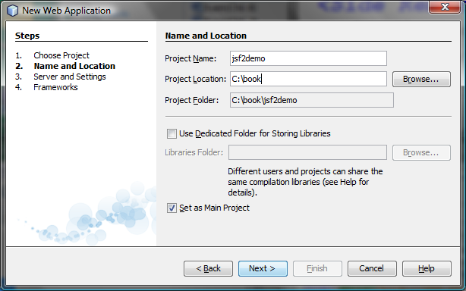
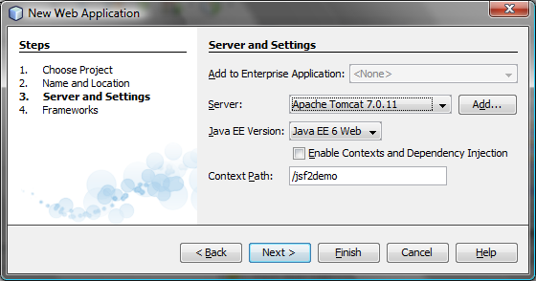
Creating a JSF Project
Create a Web project with JavaServer Faces.

Slide 5
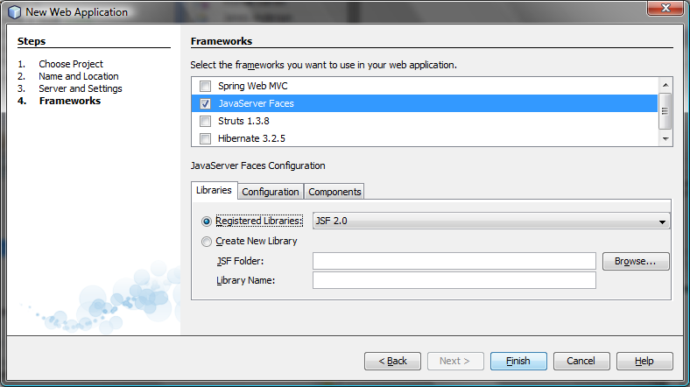
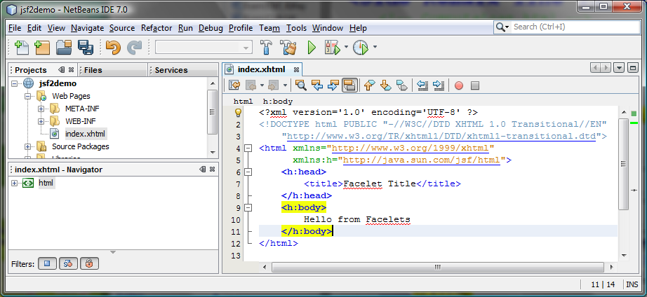
Creating a JSF Project

Slide 6
A Basic JSF Page
<?xml version='1.0' encoding='UTF-8' ?>
<!-- index.xhtml -->
<!DOCTYPE html PUBLIC "-//W3C//DTD XHTML 1.0 Transitional//EN"
"http://www.w3.org/TR/xhtml1/DTD/xhtml1-transitional.dtd">
<html xmlns="http://www.w3.org/1999/xhtml"
xmlns:h="http://java.sun.com/jsf/html">
<h:head>
<title>Facelet Title</title>
</h:head>
<h:body>
Hello from Facelets
</h:body>
</html>

Slide 7
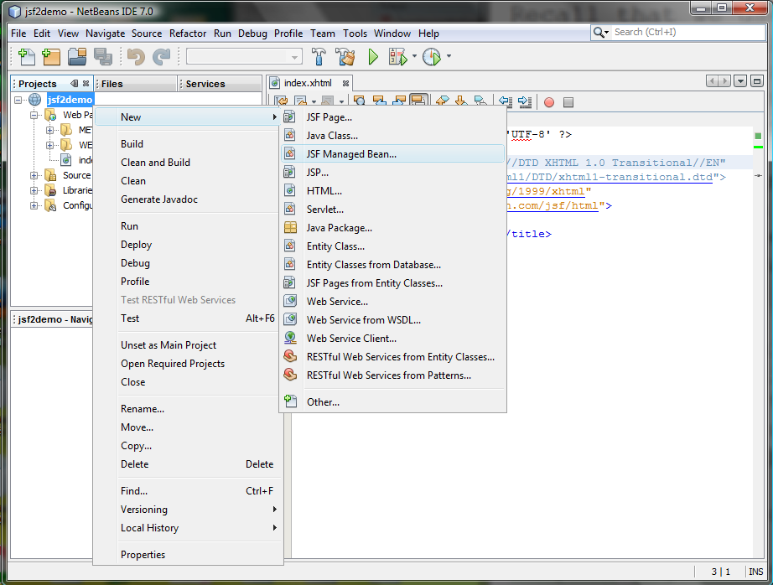
Managed JavaBeans for JSF

Slide 8
Managed JavaBeans for JSF
package jsf2demo;
import javax.faces.bean.ManagedBean;
import javax.faces.bean.RequestScoped;
@ManagedBean
@RequestScoped
public class TimeBean {
public String getTime() {
return new java.util.Date().toString();
}
}
#{expression}
#{timeBean.time}
#{timeBean.getTime()}

Slide 9
Listing 33.3 CurrentTime.xhtml
<?xml version='1.0' encoding='UTF-8' ?>
<!DOCTYPE html PUBLIC "-//W3C//DTD XHTML 1.0 Transitional//EN"
"http://www.w3.org/TR/xhtml1/DTD/xhtml1-transitional.dtd">
<html xmlns="http://www.w3.org/1999/xhtml"
xmlns:h="http://java.sun.com/jsf/html">
<h:head>
<title>Display Current Time</title>
<meta http-equiv="refresh" content ="60" />
</h:head>
<h:body>
The current time is #{timeBean.time}
</h:body>
</html>

Slide 10
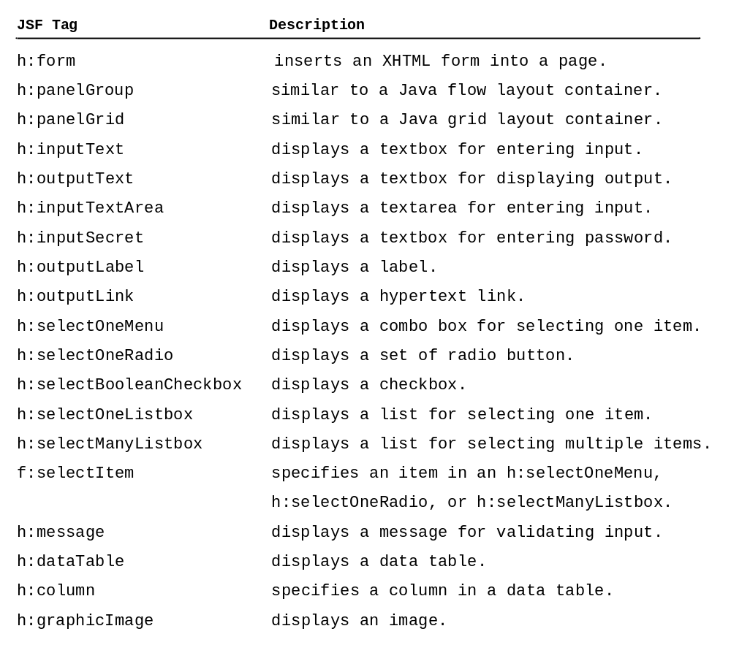
JSF GUI Components

Slide 11
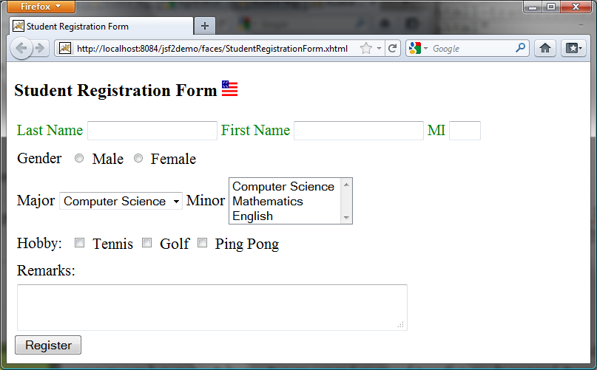
JSF UI Containers

Slide 12
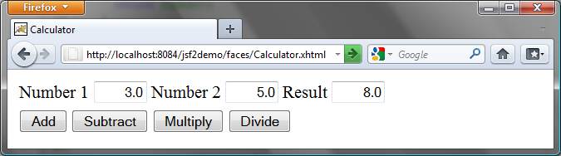
33.5 Case Study: Calculator

Slide 13
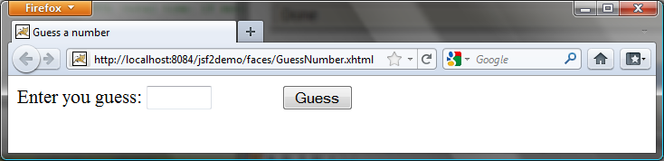
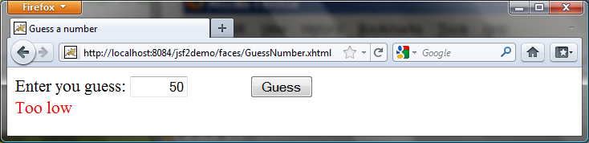
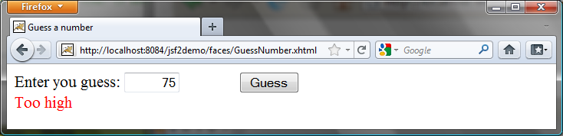
33.6 Session Tracking

Slide 14
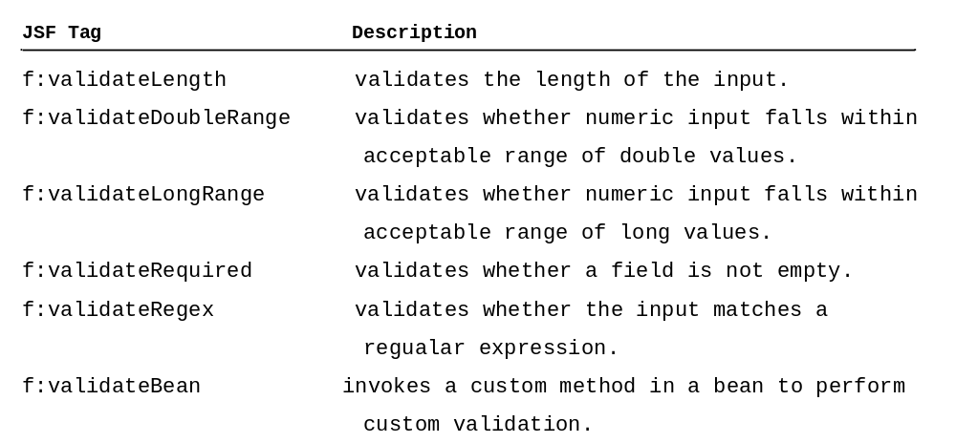
33.7 Validating Input

